Slide 1

Leveraging Primary Care to Improve Health and Reduce Costs
new options for employer groups
Presented by
[Speaker Name]
[Practice]
Notes:
[Intro].
I hope to show you today that there is a viable solution to help you decrease premiums while still providing high quality healthcare to your employees. First, I would like to introduce CPCC. CPCC is a coalition has over 400 members from the healthcare industry, business groups, government agencies and academic institutions dedicated to advancing primary care via the patient centered medical home and other value based primary care models by focusing on delivery reform, payment reform, patient engagement, workforce training and benefit redesign. I hope you will consider joining to have your voice and insights heard.
[I will periodically stop for questions during talk and at the end of the presentation, we will have information (or a broker available) to help you explore if these models make sense for you business or employees.

Slide 2
Objectives
How the health care crisis effects the premiums you pay
  Discuss the economics and landscape of the Health Care crisis
How to find quality physicians to help you keep a productive and healthy workforce
  Learn what is Primary Care and what models can bend the Health Care spending curve
Learn what you can do now to decrease costs and improve quality
Notes:
Objectives of talk are to show you that there is a viable solution to the health care crisis in Colorado and what you can do to be part of that solution. We will cover:
The Health care crisis
Why Primary care is the solution
What is primary care
Payment reform models
Business perspective
Employee perspective
Next steps

Slide 3
Introduction – Health care crisis
Notes:
Before we start, is there another question you would like addressed?

Slide 4
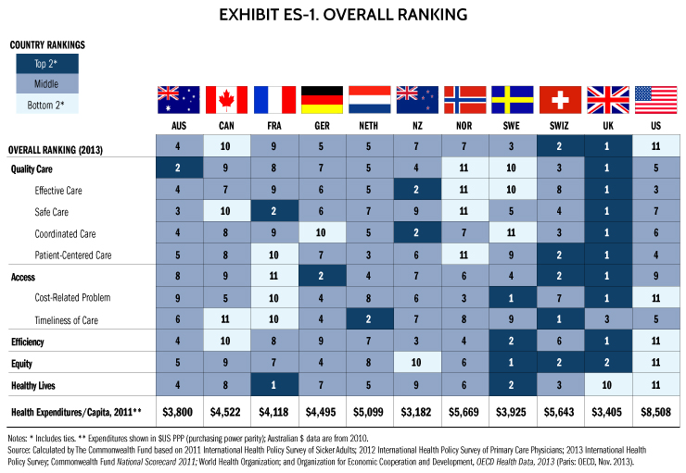
Notes:
Commonwealth Fund does extensive evaluations of the healthcare system in 11 industrialized nations ranking the key elements. Previous rankings occurred in 2004, 2006, 2007 and 2010 with this most recent ranking in 2014. USA consistently ranked last at 1.5-2.5X the cost. Paradox - US has the best care and the worst care simultaneously.
They looked at:
Quality of Care – Effective but uncoordinated and unsafe care.
Access – 37% of Americans do not get test or treatment due to cost. All other industrialized nations have universal healthcare coverage.
Efficiency – high cost of admin - in 2006, General Motors’ spent $1,500 more than Toyota in health care costs per car (Griswold DG. GM’s woes homemade, not imported. Cato Institute.
Jun 26, 2005. http://www.freetrade.org/node/378.). Poor coordination of care - 40% of patients going to ED report problem could have been addressed by regular doctor if one was available (UK 16%)
Equity – 39% of those with below average incomes report with med problem did not see doctor due to cost. Long wait periods compared to higher income patients.
Healthy Lives – US last in infant mortality and preventable deaths. Second to last in life expectancy
3. Of course, health spending data takes years to collect and represent 2011. In 2015, health spending per capita was $9,451 per capita (www.OECD.org) and expected to exceed $10,000 in 2016.
4. Summary http://www.commonwealthfund.org/publications/press-releases/2014/jun/us-health-system-ranks-last

Slide 5
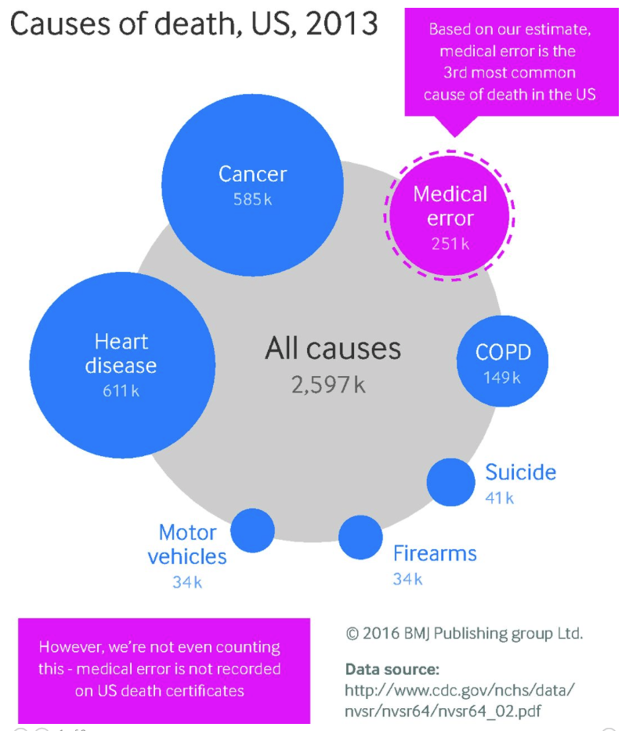
Notes:
There is a rather alarming statistic recently published in a study from Johns Hopkins in 2016 that makes these numbers seem more real.
Although US ranks #3 in effective care, we ranked #7 out of 11 industrialized nations in safe care.
3. The US Healthcare system is the 3rd leading cause of death with 250,000 deaths per year from medical error, lack of access, poor coordination, drug interactions/side effects, etc..
Johns Hopkins study reported in BMJ 2016 - http://www.bmj.com/content/353/bmj.i2139

Slide 6
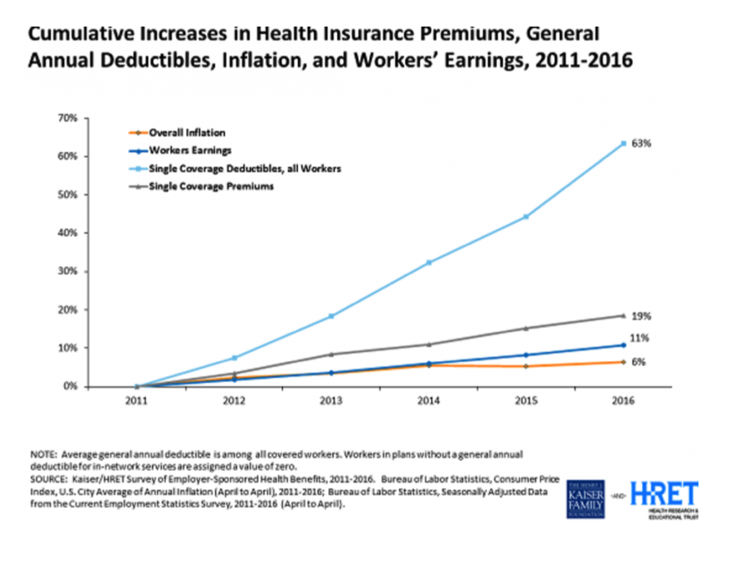
Notes:
The US ranks # 11 in Efficiency, Equity, and Access this leads to Health insurance premiums significantly outpacing employee salary increases and inflation.
Health care expense $3T (CDC 2014)
17.5% GDP (CDC 2014)
2016 predicted to hit close to 20% of GDP and $4T (Health Affairs)

Slide 7
Annual Health Insurance Premiums and Household Income, 1996 to 2005
(Robert Graham Center: Devoe et al)
Annual Health Insurance Premiums and Household Income, 1996 to 2005
(Robert Graham Center: Devoe et al)
Notes:
Health insurance premiums will equal total household income in 2025. In an updated model published 2012, they estimate (due to economic downturn and PPACA) that this threshold will be crossed
in 2033, and under favorable assumptions the PPACA may extend this date only to 2037 (Ann Fam Med 2012;10:156-162. doi:10.1370/afm.1348.).
If health care costs continue to rise at current unsustainable rates, it is doubtful that affordable insurance coverage will be available for low- to middle-income Americans in the near future.

Slide 8
Where does the Dollar Go? Primary Care Remains Undervalued
U.S. per-capita health spending, 2012
(under 65 with employer-sponsored health insurance)
Notes:
Hospital services consume 50% of health care dollar.
Only 4% of the healthcare dollar goes to primary care. Countries with successful healthcare spend more on primary care, Generally > 20%.
UK (ranked #1 by Commonwealth) spends 24% on primary care services (2012) - (http://www.pharmatimes.com/news/english_nhs_spending_primary_care_down%2C_hospitals_up_1004589)
Australia (ranked #4 by Commonwealth) spends 34% on primary care services- (http://www.aihw.gov.au/media-release-detail/?id=60129550067)
Ireland spends 24% (2014) http://www.imt.ie/news/just-how-much-is-spent-on-primary-care-28-05-2014/
AAFP recommends increasing primary care payments to 10-12% of total health care spending to provide the adequate primary care foundation to support a healthy healthcare system-(2011)- http://www.aafp.org/dam/AAFP/documents/advocacy/payment/medicare/feesched/LT-BidenPanel-062011.pdf

Slide 9
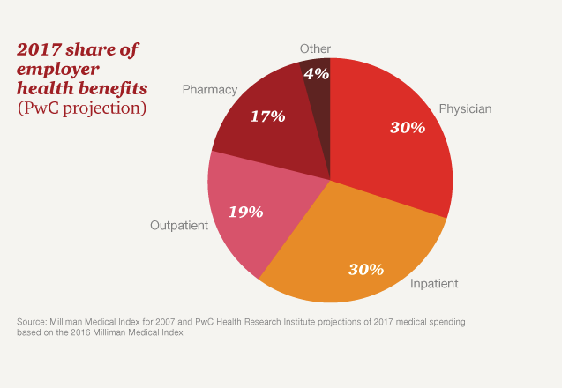
Employer Health Costs - 2017 projections
Notes:
Employer expenses mirror the the US data with 50% of costs from hospital in-patient and out-patient services.

Slide 10

The Cost of Poor Health to Employers
Personal Health Costs
Medical Care
Pharmaceutical costs
Workers’ Compensation Costs
30%
Iceberg
of Additional Costs to Employers from Poor Health
Productivity Costs
70%
Absenteeism
Short-term Disability Long-term Disability
Presenteeism
Overtime
Turnover
Temporary Staffing
Administrative Costs
Replacement Training
Off-Site Travel for Care
Customer Dissatisfaction
Variable Product Quality
Sources: Loeppke, R., et al., "Health and Productivity as a Business Strategy: A Multi-Employer Study", JOEM.2009; 51(4):411-428. and Edington DW, Burton WN. Health and Productivity. In McCunney RJ, Editor. A Practical Approach to Occupational and Environmental Medicine. 3rd edition. Philadelphia, PA. Lippincott, Williams and Wilkens; 2003: 40-152
Notes:
Medical costs are just the tip of the iceberg
Employer costs eclipse medical costs by 2:1 from absenteeism and presenteeism that decrease productivity, increase admin costs, increase replacement training, effect product quality and customer satisfaction.
10

Slide 11
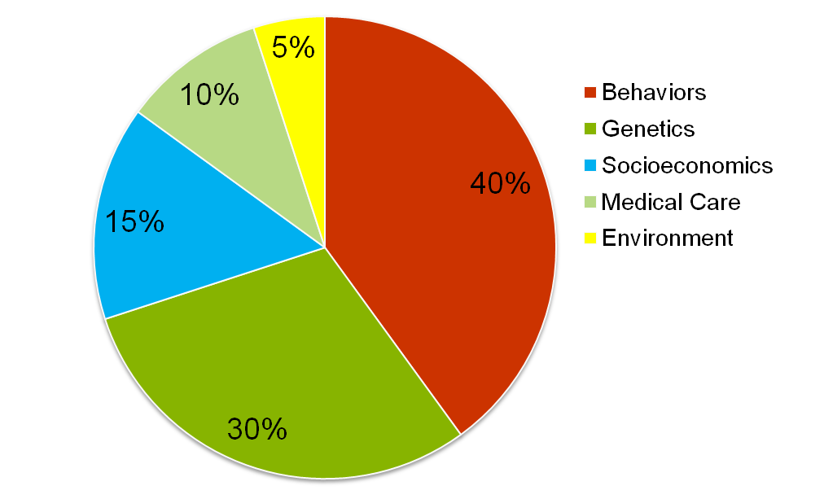
What determines Premature Death?
McGinnis JM, Foege WH. Actual Causes of Death in the United States. JAMA 1993;270:2207-12.
Mokdad AH, Marks JS, Stroup DF, Gerberding JL. Actual Causes of Death in the United States, 2000. JAMA 2004;291:1230-1245.
11
Notes:
11
11
We talked a lot about the economics of health care. What factors determine health and disease?
60% of premature death is caused by human behaviors (smoking, diet, sedentary lifestyle, alcohol, substance abuse), psychosocial (depression, mental illness, stress, poverty, suicide [#4]) and environmental conditions (pollution, accidents [#10], poisonings, weather).

Slide 12
Top 10 Health Conditions Driving Costs for Employers (Med + Rx + Absenteeism + Presenteeism)
Costs/1000 FTEs
Loeppke, et al., JOEM. 2009;51(4):411-428.
12
Notes:
Majority of health conditions are caused or related to the behavioral, psychosocial, or environmental factors of disease and can be prevented, managed or coordinated by primary care.
Primary care can reduce costs through “shared decision making”. Shared decision making is a process where the physician and patient discuss their condition and their options to determine what is best for them taking into account their feelings, desires and circumstances i.e. what is right for them.

Slide 13
What is Primary Care?
Notes:
Before we move on, any questions on healthcare economics?

Slide 14
What is Primary Care
Primary care is the provision of integrated, accessible health care services by
clinicians who are accountable for addressing a large majority of personal health
care needs, developing a sustained partnership with patients, and practicing in
the context of family and community.
Primary Care – America’s Health in a New Era, Donaldson. IOM. 1996
First Contact – Accessible – Longitudinal – Comprehensive
Starfield (1992)
Notes:
Primary care provides the Right care (with the Right clinician) at the Right time in the Right place over your lifetime.
Primary care can provide 80% of your healthcare needs and ensure safe navigation through the healthcare system when needed.
In other words,
...it is a relationship between clinician and patient (and family) that addresses most of the health-related problems of most patients, most of the time.
Who provides it?
The Primary Care Clinician is usually a Family doctor, Obstetrician, Pediatrician, Internist or appropriately trained Nurse Practitioner or Physician’s Assistant

Slide 15
The Evidence for Primary Care
“Evidence of the health-promoting influence of primary care has been accumulating ever since researchers have been able to distinguish primary care from other aspects of the health services delivery system.
  This evidence shows that primary care helps prevent illness and death, regardless of whether the care is characterized by supply of primary care physicians, a relationship with a source of primary care, or the receipt of important features of primary care.
  The evidence also shows that primary care (in contrast to specialty care) is associated with a more equitable distribution of health in populations, a finding that holds in both cross-national and within-national studies”
CONTRIBUTION OF PRIMARY CARE TO HEALTH SYSTEMS AND HEALTH, Starfield et al, Milbank Quarterly, Volume 83, Issue 3 (pp 457–502). 2005
Milbank Memorial Fund – PCPCC 2016
Notes:
Why is Primary Care the solution for the health care crisis?
The concept of primary care dates back to 1920 in the Dawson Report that encouraged Great Britain (ranked #1 by Commonwealth) to make primary care the foundation of their healthcare system. Primary care has been vigorously studied since1990s (over 100 national and international studies) showing regardless of the demographics, environment, or Health care System that primary care helps prevent illness/death and provides more equitable healthcare.

Slide 16
Evidence for Primary Care
Primary care physicians: 1 per 10,000 more primary care physicians decreases mortality by 40 per 100,000 (5% fewer deaths).
Family Physicians: 1 per 10,000 (12.6%) more family physicians decreases mortality by 70 per 100,000 (9% fewer deaths or 127,617 lives saved).
Shi. J Am Board Fam Pract 2003;16:412-22.
Notes:
16
Family physicians have the most impact on health of population. When the supply of primary care physicians (internist, pediatricians, family physicians) was disaggregated into family physicians, general internists, and pediatricians, only the supply of family physicians showed a significant relationship to lower mortality (9% or 127,617 lives saved) which probably reflects the continuity and comprehensive aspects of Family Medicine.
Curiously, more specialists increase mortality but that probably reflects other issues in the healthcare system to be discussed and not quality of their care.
Currently, 7-8 primary care physicians per 10,000 people in urban areas.

Slide 17
Fragmented Care Leads to Higher Costs
More DIFFERENT specialists seen: higher total costs, medical costs, diagnostic tests and interventions, and types of medication*.
  Inappropriate referrals to specialists lead to more tests, false positives, poorer outcomes than appropriate referrals.
Health care costs are higher in regions with higher ratios of specialists to generalists
Welch et al. NEJM 1993;328:621
*Using the Johns Hopkins Adjusted Clinical Groups (ACGs) Starfield et al, Ambulatory specialist use by patients in US health plans: correlates and consequences. Submitted 2008.
Notes:
08 Oslo Importance of PC Oct
9/1/2017
17
Why is primary care’s problem, your problem?
The inability to have the time and focus to manage and coordinate care leads to fragmented care and higher costs.

Slide 18
Cost of uncoordinated care and waste in 2012
$750,000,000,000
“Health Policy Brief: Reducing Waste in Health Care,” Health Affairs, December 13, 2012.
Notes:
1. Cost of uncoordinated care ,“waste” and fraud accounts for 30-40% of health care dollar (an additional $98B to fraud and abuse) http://healthaffairs.org/healthpolicybriefs/brief_pdfs/healthpolicybrief_82.pdf
2. An example is waste in MRI testing and surgery for back pain. In a national survey of 2000 orthopedists in 50 states, 96% of orthopedist reported practicing defensive medicine and 31% of orthopedists report ordering MRIs unnecessarily due to liability at an estimated cost of $2B. 77% respondents would order less tests if medico-legal reform. 84% reduced high risk procedures decreasing access to needed care. (Jahangir, Alex Amer J Ortho Feb 2013)

Slide 19
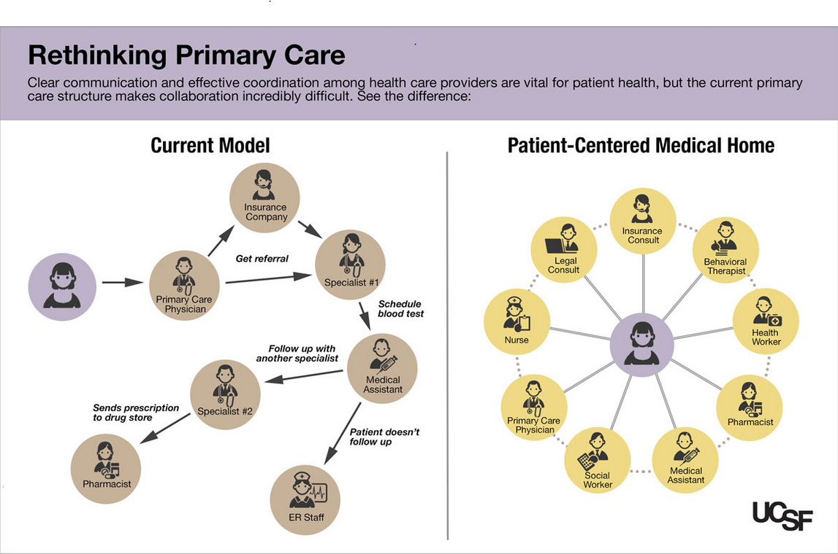
Source: UCSF Center for Excellence in Primary Care. http://www.ucsf.edu/news/2014/08/116856/team-based-approach-primary-care.
Notes:
Do not need to reinvent the wheel – just redesign it. Current model fragments and uncoordinated to a patient centered model where the patient is at the center and a team envelops them to safely and effectively navigate the health care system while receiving the resources/care they need to maintain/regain their health and reducing costs, reducing harm and improving outcomes.

Slide 20
Changing to a new Paradigm
Today | Future
Treating Sickness / Episodic | Managing Populations
Fragmented Care | Collaborative Care
Specialty Driven | Primary Care Driven
Isolated Patient Files | Integrated Electronic Records
Utilization Management | Evidence-Based Medicine
Fee for Service | Shared Risk/Reward
Payment for Volume | Payment for Value
Adversarial Payer-Provider Relations | Cooperative Payer-Provider Relations
“Everyone For Themselves” | Joint Contracting
Notes:
Change the paradigm from fragmented care to team care with all stakeholders (physicians, patients, employers, health plans) working together – provide personalized care while managing populations, going from fragmented care to collaborative care, primary care driven system using integrated records and evidence based medicine to provide value.

Slide 21
Payment Reform Models
Notes:
[Questions]

Slide 22
Quintuple Aim
Better Outcomes
Improved Patient Experience
Competitive Business Advantage
Physician and Staff Well-Being
Lower Costs
Frank Reed, M.D., Professor of Family Medicine, Univ. of Montana, 2017
Notes:
The Triple Aim of better quality of care, improved patient experience and decreased healthcare costs are the goal of all reform efforts. As we have seen, however, Primary care cannot carry the burden of what is being asked.
The Triple Aim plus physician and staff well-being = The Quadruple Aim which is necessary for sustainable reform.
Evolve to the Quintuple Aim

Slide 23
3 Possible Futures
Shift of health care costs to patients.
Government imposes price control on health care goods and services.
  Harris poll: 40% decrease physician payment; 44% decrease hospital payment; 66% decrease Rx cost
Payment reform and care delivery redesign bends the cost curve through integration and creating value.
Kim Slocum
Texas Health Institute
KDS Consulting
2011
Notes:
What does the future hold…
1. Currently, there are efforts to shift costs to patients but this just decreases access to care and ultimately increases costs. 30% of employers reported having reduced the scope of health benefits or increased cost sharing, and 23% increased the share of the premium a worker has to pay (Ann Fam Med 2012;10:156-162. doi:10.1370/afm.1348.)
2. Government price control did not work very well in the 1970s. Technology and big data may help but are not the answer.
3. A combination of care delivery redesign and payment reform is the only viable answer.

Slide 24
A Value-based Health System
Health Status / Reversibility
Health care spending
Early
Clinical
Symptoms
Healthy/
Low Risk
High
Risk
Active
Disease
At-Risk
20% of people
generate
80% of costs
Time
Personal Lifestyle Plan
Risk Modification
Disease Treatment
and Management
Source: IBM Global Business Services and IBM Institute for Business Value, adapted from Ralph Synderman
Notes:
This care delivery redesign requires a transition from volume-based to value-base health care
A value-based system should appropriately balance resources expended in keeping people healthy and in treating sickness. Today in the US we have a “sick care system” not a “health care system”. For example, despite most of the costs in our system coming from patients with chronic illnesses,
Our system is geared toward acute interventions. 1% of patients account for 22% of costs, 5% of patients account for 50% of costs and 20% account for 80% (AHRQ 2009). In the top 10% of health care spenders, only 40% were >65, 80% were Caucasian so it is a general societal problem and not originating from any one group.
The best financial rewards are generally for spectacular acute interventions
Illustrating with a specific US example, it’s hard to buy services today help keep a pre-diabetic from becoming a diabetic. It’s also hard to buy the services needed to help keep a diabetic’s condition from deteriorating even though we think we know what to do(e.g., regular monitoring of A1C, cholesterol and blood pressure; regular eye and foot exams, etc). It’s easy to buy a world-class foot amputation or kidney transplant in today’s system. While there will continue to be a need for acute interventions, we need a system that focuses more on personalized prevention, prediction, early detection / treatment, and care coordination (e.g. case management or chronic disease management combined with secondary prevention), etc.
In short, the healthcare system in the US is not selling what purchasers or large employers want to buy.
So if the goal of a value-based system should be to appropriately balance resources expended in keeping people healthy and in treating sickness, then how would a value-based health care system be defined and measured?

Slide 25
Payment Models for Health Care Reform
Fee-for-service based
Fee-for-service
Fee-for-performance (FFS + bonus for quality measures)
PCMH (FFS + Capitation)
Capitation based
Traditional capitation
Bundled payments
Direct Primary Care
Blended (FFS ± Capitation ±Bonuses)
Shared Savings (FFS/capitation + bonuses)
Comprehensive Primary Care Payment (capitation + bonuses)
Notes:
Payment reform can be divided into 3 basic models. CPCC supports the PCMH and DPC as the two most viable models.

Slide 26


Defining the Patient-Centered Medical Home
The medical home is an approach to primary care that is:
Person-Centered
Supports patients and families in managing decisions and care plans
Comprehensive
Whole-person care provided by a team
Coordinated
Care is organized across the ‘medical neighborhood’
Committed to Quality and Safety
Maximizes use of health IT, decision support and other tools
Accessible
Care is delivered with short waiting times, 24/7 access and extended in-person hours
Source: www.ahrq.gov
Notes:
5 basic principles of PCMH mirror the definition of primary care. Defined by NCQA in a recognition program – 50 pages of detailed deliverables. It takes six months to over a year to make the transition at an estimated cost of $10-90,000 per physician (Gans, MGMA). depending on the size of the practice. The cost to maintain a PCMH (15 practices in CO and UT) is $105,000 per physician per year due to increase staff, lost revenue, increased hours, med supplies/device, facility costs and IT but not counting EHR . (ANNALS OF FAMILY MEDICINE ✦ WWW.ANNFAMMED.ORG ✦ VOL. 13, NO. 5 ✦ SEPTEMBER/OCTOBER 2015)

Slide 27

Colorado PCMH Pilot 2009-2011: Anthem Year 2 Data
18% decrease in acute IP admissions/1000, compared to 18% increase in control group 15% decrease in total ER visits/1000, compared to 4% increase in control group Prescriptions/1000 increased as compared to control group Specialty visits/1000 remained around flat compared to 10% increase in control group Overall Return on Investment estimates ranged between 2.5:1 and 4.5:1
Notes:
PCMH proven model in 21 of 23 studies since 2009.
CO PCMH Pilot participants - Anthem, UHC, Cigna, Aetna, Humana, Medicaid
Quality improvement in nearly all diabetes measures
3.6% decrease in acute IP admissions per 1000 per year
6.1% decrease in total ER visits per 1000 per year
2% decrease in specialist visits per 1000 per year
1.3% increase in persistent medication usage
IP rate per 1000 between 12% - 23% lower for PCMH providers
ER rate per 1000 between 11% - 17% lower for PCMH providers
Total medical and Rx cost for PCMH members was 14.5% lower than for members seeing non-PCMH providers

Slide 28
PCMH Reported Outcomes: Cost Savings
Program | Outcomes | Date Published | Report Type
Anthem BC ACO | $4.7 Million (in 6 months) | June 2014 | Industry Report
BCBS Michigan PCMH Program | $26.37 PMPM (2009-2010) $155 million (2008-2011) | July 2013 | Peer-Reviewed
Oregon Coordinated Care Organizations (Medicaid) | 18-19% reduction in ED visit spending | Nov 2013, June 2014 | Industry Report
Vermont Blueprint for Health (Multi-Payer) | Reduced expenditures in 2012 by: $386 PMPY commercial (ages 1-17) $586 PMPY commercial (ages 18-64) $200 PMPY Medicaid (ages 1-17) $447 PMPY Medicaid (ages 18-64) | Jan 2014 | Industry Report
CareFirst BCBS PCMH Program (DC, MD, VA) | $267 million avoided costs (2011-2013) | July 2014 | Industry Report
Monarch Healthcare CMS Pioneer ACO (CA) | 5.4% reduction in medical costs in 2012 (Medicare) | Jan 2014 | Industry Report
Horizon BCBS of New Jersey PCMH Program | $4.5 million savings (ER visits and hospitalizations) 4% lower total cost of care (all patients) 4% lower cost of care (diabetes patients) | July 2014 | Industry Report
Independence BC PCMH Program (PA) | Total cost savings for high risk groups: 7.9% and 11.2% (2010, 2009) | March 2014 | Peer-Reviewed
Source: Primary Care Innovations and PCMH Map by Outcomes. PCPCC. Accessed September 2014. http://www.pcpcc.org/initiatives/evidence
Notes:
Examples of 21 of 23 studies with positive results since 2009.
Cost savings have been in particular associated with targeting high utilizers, multipayer collaborations, sharing responsibility for care amongst a larger network, providing timely data sharing and feedback (tracking across the medical neighborhood). Practice transformation costs are significant and near impossible without payment reform. Recent PCPCC report- 21/23 projects that reported on cost or utilization found reductions in at least one measure.
PCPCC’s compiled source of programs (Filter results by “cost savings”): http://www.pcpcc.org/initiatives/evidence
Source: Primary Care Innovations and PCMH Map by Outcomes. PCPCC. Accessed January 2015. http://www.pcpcc.org/initiatives/evidence

Slide 29



Patient Satisfaction - PCMH
Fall 2010
Summer 2011
96%
Spring 2012
96%
94%
Feel they get care when they need it
96%
98%
98%
Would recommend their practice
to friends and family
95%
94%
94%
Find their clinics well-organized,
efficient and respectful of their time
98%
95%
95%
Find it easy to speak to a physician
Notes:
High patient satisfaction in CO PCMH Pilot during transformation.

Slide 30
Colorado PCMH Pilot
Joint Principle Model
$0
FEE FOR SERVICE
CARE MGMT FEE
(PMPM)
PAY FOR PERFORMANCE (BONUS)
SHARED INCENTIVES FOR MEDICAL NEIGHBORHOOD
PATIENT CENTERED MEDICAL HOME
Notes:
CO Pilot payment model was mostly FFS. PMPM was attributed to only about 15% of practice panel although PCMH work applied to whole practice due to non-participating health plans and self-funded businesses (ASO) that did not participate. P4P provided small bonus for achieving benchmarks.
Positives- Proven model to achieve Triple Aim in 21 of 23 positive studies since 2009. PMPM is more flexible (adaptable to urban, rural, large, small practices) to be used for infrastructure, team based care, population management, coordination etc. Both a Practice Redesign and Payment Reform model.
Negatives- still grounded in FFS with all of its downsides. High initial ($40,000-$90,000 per physician) and annual investment to maintain ($100,000 per physician per year). Need adequate risk-adjustment to avoid incentives to cherry pick.
Risk- similar to FFS, more risk on practices to manage PMPM fees (also depends on if this comes with decreased FFS payments)

Slide 31

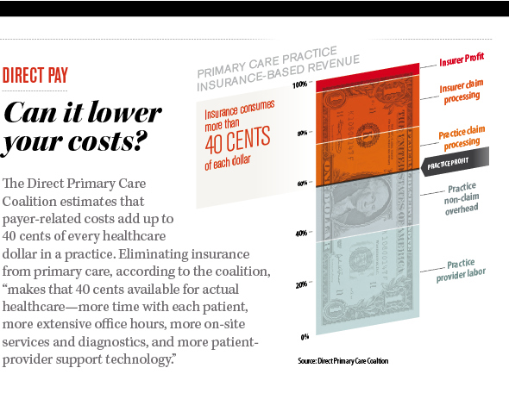




What is Direct Primary Care?
An innovative payment model between Patients, Employers, Providers and Insurers. Patient or employer pays monthly fee to practice for primary care services.
Goal: Patient-Employees strive to improve health because Providers are not confined to traditional payment models for health care delivery.
Notes:
Patients still buy insurance (catastrophic plans)… but generally can view as a solution going entirely outside of the system
Positives – better patient and provider satisfaction generally with reduced panel sizes, longer visits, enhanced access
Negatives – potential for higher patient cost sharing, potential to worsen primary care shortage (caveat that may keep people from leaving it)
Proactive
Risk – patients to a large extent for anything outside of their included primary care services, providers with regard to basic primary care

Slide 32
What is Direct Primary Care?
How? Financial Snapshot
  Employers
    Goal: Reduce cost of offering health insurance to employees; increase employee productivity/decrease presenteeism
DPC
Monthly Fee
Health Insurance Plan*
Do you currently offer a plan? None?
High-deductible and/or Co-pay plans?
*If no insurance, will pay mandate penalty.
Employee Medical Benefits Package
+
Notes:
Model consist of a monthly fee that covers almost all of primary care services coupled to catastrophic coverage from a health insurance plan.

Slide 33
Acute Care
Chronic Illness Management
Preventive Care & Annual Well Visits
Some Vaccinations, Cultures available
(detailed list of services available)
Employee-Patient
Primary Care
Wellness Care
Care Coordination
Access & Time
Practice Services
Sameday Appointments
Televideo Visits
Early Morning/Late Evening Hours
Weekend Hours
Online Portal Messaging
Discounted Services or through HSA:
Laboratory Services
Medical Imaging
Notes:
A different model that achieves PCMH principles. Excels at enhanced access (first contact and accessibility) and continuity. Physician has more time to provide more comprehensive services.

Slide 34
DPC – The Evidence
Nextera – Colorado DPC
Digital Globe with 1,300 employees in 2016
7 month study – 205 employees and dependents
14.4% reduced health care costs
Savings $155.30 PMPM
Qliance – Seattle DPC with 4000 members
19.6% reduction in costs in 2 year analysis
95% patient satisfaction
Notes:
Proven to achieve the Quadruple Aim

Slide 35
Direct Primary Care
Insight Primary Care ,Denver Stapleton
Family of 4 | Traditional Insurance | DPC + high deductible ins.
Annual Premium | $15,350 | $7,150
Primary Care | 0 | $2,352
Total | $15,350 | $9,502
Savings | 0 | $5,848
http://www.insightprimary.com/ Accessed 4.24.13

Slide 36
Employer’s and Employee’s Perspective
What’s in it for me?
Notes:
[Questions]

Slide 37
Employer Perspectives on Health Benefits
In a small business health benefits survey, a majority of small business owners reported positive effects of offering health insurance for employees:
78 % said it increased loyalty and decreased turnover.
75 % said it helped employee recruitment.
64 % said it increased productivity by keeping employees healthy.
62 % said that employees demanded or expected health insurance.
58 % said it reduced absenteeism by keeping employees healthy.
*Source: Blue Cross and Blue Shield Association Analysis of 2002 Small Employer Health Benefits Survey, sponsored by the Blue Cross and Blue Shield Association (BCBSA), the Employee Benefit Research Institute (EBRI), and the Consumer Health Education Council (CHEC).
Notes:
Since the 1940s, employers have provided health benefits to their employees with positive effects

Slide 38
Employer & Employee Advantages
PCMH
Reduced health care costs.
Better Access to Care for Employees
Comprehensive primary care
Population management and enhanced care coordination
Better health outcomes
Continuity of care
Increase employee satisfaction
High quality, safe medical care
DPC
    Simple, clear, expected payment for care
Reduced health plan costs offering a better value.
Improved and consistent quality of care and patient satisfaction
Better Access to Care for Employees
Complete Price transparency
Reduces out-of-pocket expenses
Reduced Absenteeism
Better Employee Recruitment and Retention
Increased Loyalty
Employer & Employee Tax Benefits (pre-tax premiums)
Notes:
Have shown how these two primary care models result in many advantages to both the employer and employee producing better health care outcomes with reduced costs. PCMH and DPC overlap in many areas of quality of care but differ in payment design.
PCMH- works with traditional insurance coverage with added payments to cover team care and coordination of care
DPC – primary care carve-out coupled to catastrophic health insurance
How can you, the employer, share in the cost savings from these models?

Slide 39
Next Steps

Slide 40
Learn more and explore your options!
Join the Colorado Primary Care Collaborative https://www.coloradoafp.org/advocacy/colorado-primary-care-collaborative/
Ask your Health Plan to invest in the PCMH and support adoption
Ask your Health Plan to provide a wrap around or high deductible plan to support DPC
Contact your health care broker and ask how your Group Health Plan can coordinate with the PCMH or DPC model
Customize Care for your Employer Group
  Health Risk Assessment to determine the health needs of your employees
  Develop health indicators to improve across Employee population
Steer your employees to PCMH and DPC practices now
  Check the CAFP database for PCMH practices in Colorado
  Check the CAFP database for Direct Primary Care practices in Colorado
Contact Ryan Biehle (ryan@coloradoafp.org) at the Colorado Academy of Family Physicians 303-696-6655 x17
Notes:
What you can do now to be part of the solution?

Slide 41
A vision without a task is but a dream; a task without a vision is drudgery; a vision and a task is the hope of the world.
Inscription on a church
Sussex, England
Notes:
We have the vision and we have a concrete plan. We are doing the work. Together we can make a difference and and together we can solve the problems of health care in CO. I hope you join us and take the next steps.

