Slide 1
Tar Wars

Slide 2


Slide 3
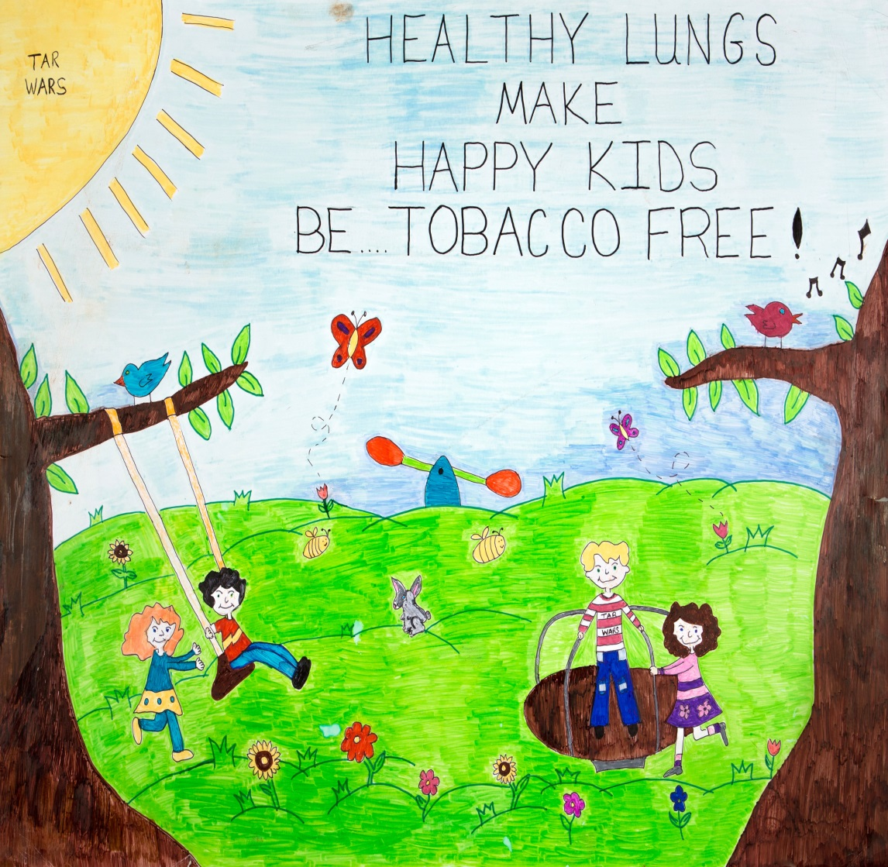
What is Tar Wars?
A tobacco-free education program for 4th- and 5th-grade students
A way to learn interesting facts on staying healthy
An interactive and fun curriculum
Abby—Tennessee
2014 Poster

Slide 4
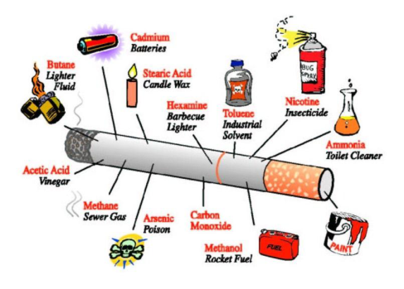
What’s in a cigarette?
There are about 600
ingredients in cigarettes.
Cigarettes contain:
Acetone (found in nail polish remover)
Butane (found in lighter fluid)
Lead (found in batteries)
Tar (used to pave roads)
Ammonia (found in toilet cleaner)

Slide 5
“Sticky Person”
What are some health effects of tobacco use?
Trouble breathing
Coughing
Bad breath
Stained teeth and fingers
More wrinkles and early aging

Slide 6
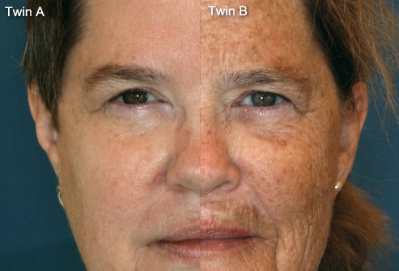
How does tobacco affect your body?
Did not smoke Smoked
Nicotine is a stimulant.
Tobacco use damages the lungs and blood vessels.
It also affects appearance.
MedicineNet.com http://www.medicinenet.com/smoking_effects_pictures_slideshow/article.htm

Slide 7

How much does tobacco use cost?
Price of tobacco
What you could buy instead
$6 per pack x 7 days = $42
$42 per week x 4 weeks
= $168
$168 per month x 12 months = $2,016
$2,016 per year x 10 years
= $20,160
Clothes, shoes, games
iTouch, Playstation, Xbox
Laptop computer, iPads, many games
Car, college tuition

Slide 8

Why do people use tobacco?
Peer pressure: others want you to try tobacco
Image: to look cool, older, or more grown up, or to feel popular
Mood: to try to relax
(but tobacco has the opposite effect)
Addiction: once you start, you can’t stop

Slide 9
The Power of Advertising
Tobacco companies spend billions of dollars each year to promote their products.
Tobacco ads are designed to attract people and motivate them to buy and use the products.
People who use tobacco are shown as young, attractive, and cool, but the ads never show the brown teeth, wrinkles, spit stains, and phlegm that result from its use.

Slide 10
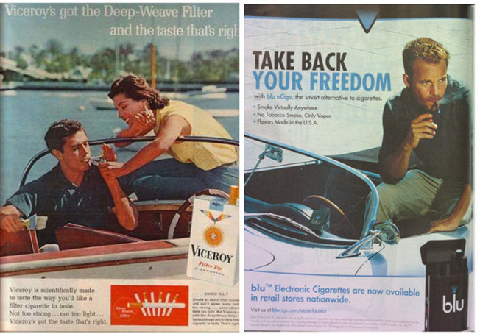
Marketing Tactics
Ad from 1964 Ad from 2013

Slide 11
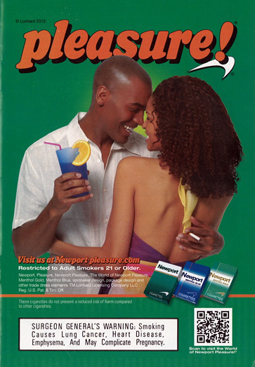
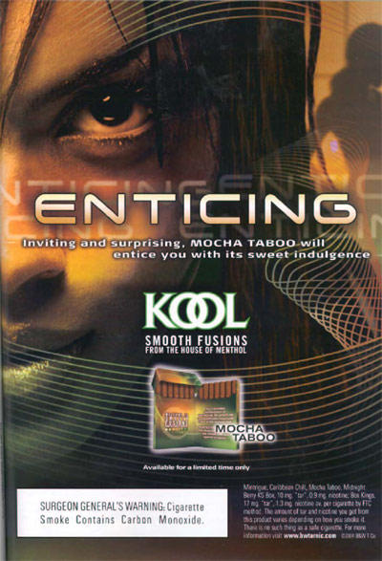
Tobacco Ads in Magazines

Slide 12
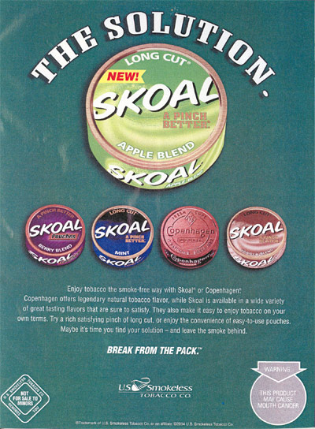
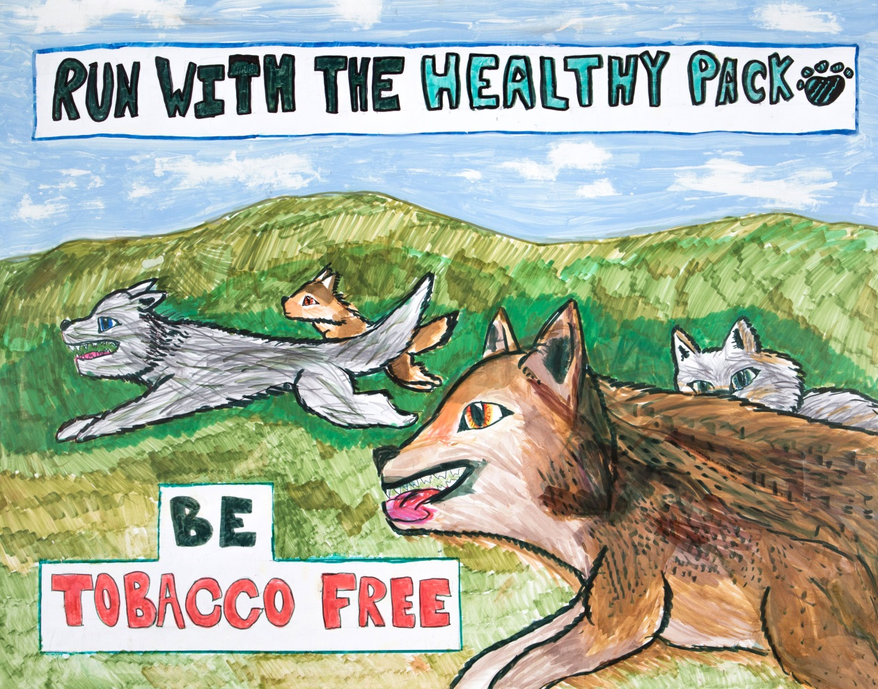
Break from the Pack vs.
Run with the Healthy Pack
Alina—New York
2014 Poster

Slide 13
Flavored Smokeless Tobacco
Comes in sweet and fruity flavors to mask the taste of nicotine
Available in orbs, sticks, strips, lozenges, snuff, and small bags/cans
Designed to be placed in the mouth and dissolve so nicotine absorbs into the bloodstream
Smokeless tobacco is not a safe
alternative to cigarettes.

Slide 14
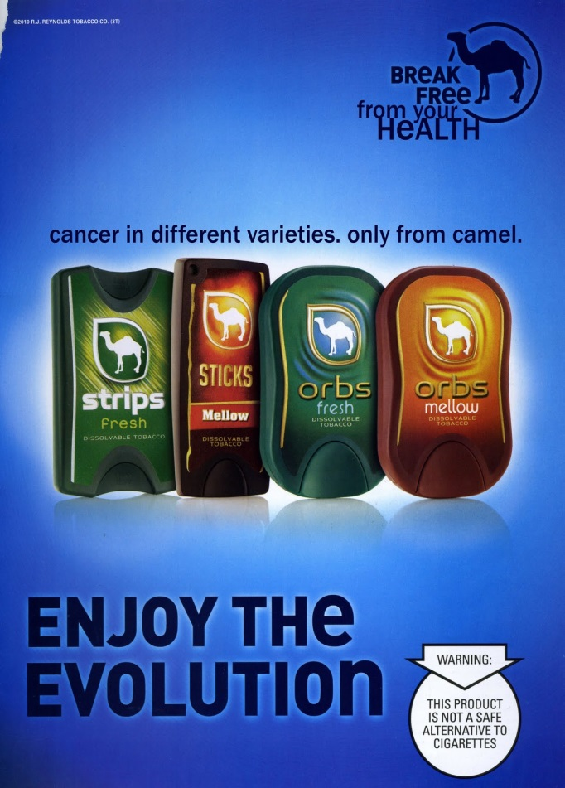
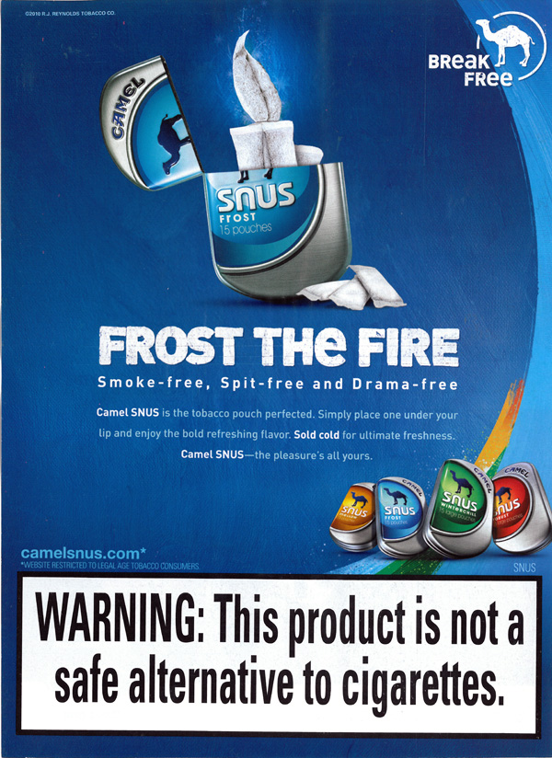
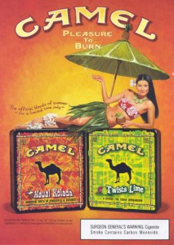
Flavored Smokeless
Tobacco Products

Slide 15
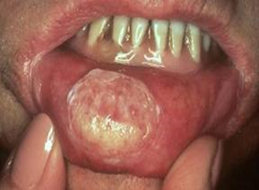
Just as Harmful as Cigarettes
The chemicals in smokeless tobacco destroy cells and tissues, which leads to:
Mouth sores

Slide 16
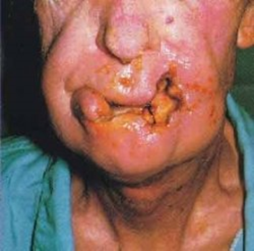
AND oral cancer

Slide 17
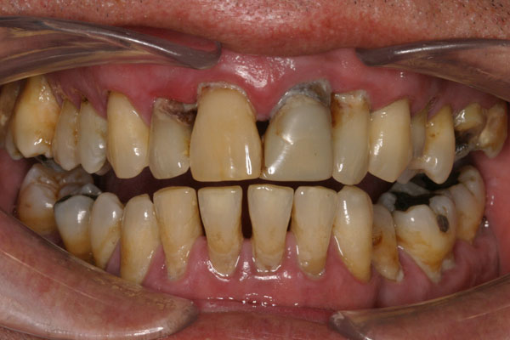
AND stained teeth,
tooth loss, and
receding gums

Slide 18
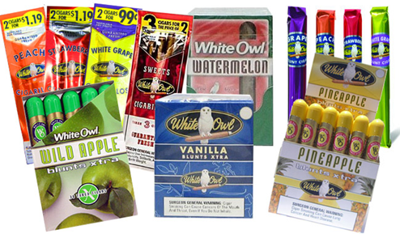
Flavored Cigars and Cigarillos
Cigars and cigarillos come in flavors such as vanilla, pineapple, watermelon, and apple.
They are flavored to attract young people and encourage them to
try the product.
Cigars and cigarillos contain nicotine and are bad for your health.

Slide 19
Flavored Cigars and Cigarillos
Using cigars and cigarillos doubles the risk of oral cancer, even if you don’t inhale.
In one study, the amount of carbon monoxide from cigars was more than the amount found on a busy highway in California.
Cigars and cigarillos are not a safe
alternative to cigarettes.

Slide 20
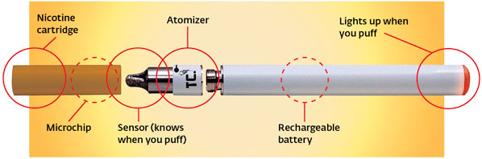
Electronic Cigarettes (E-Cigs)
E-cigs are marketed to young people as an alternative to cigarette smoking and come in many flavors.
The cartridges used in e-cigs contain nicotine and other chemicals.
E-cigs are not a safe alternative to cigarettes.

Slide 21
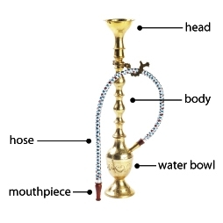
Hookahs
A hookah is a water pipe used to smoke tobacco.
The heated tobacco passes through a water bowl, and the smoke is inhaled through a mouthpiece.

Slide 22
Hookahs
Hookah smokers:
Inhale large amounts of smoke and are exposed to 100 to 200 times the amount of smoke in a cigarette.
Inhale more nicotine than cigarette smokers.
Share mouthpieces and risk getting colds, the flu, oral herpes, and other illnesses.

Slide 23
Secondhand Smoke
Secondhand smoke is a combination of the smoke coming from the burning end of a lit cigarette, cigar, cigarillo, or pipe and the smoke that is exhaled by a smoker.
This smoke contains cancer-causing agents and chemical compounds.
There is no safe level of secondhand smoke.
Is your community 100% smoke free?

Slide 24
Effects on Breathing:
“Straw Breathing” Exercise
Any type of smoking affects your breathing.
To see how your lungs feel when you smoke, place a straw in your mouth, hold your nose, breathe only through the straw, and run in place for one minute.
Is it hard to breathe?
Watch the smoker’s lung demonstration video to see how tobacco causes your lungs to not work as well as they should.

Slide 25
Lung Damage from Smoke
Smoke from cigars, cigarillos, cigarettes, pipes, and hookahs damages the cells of the lungs.
People who smoke are more likely to have trouble breathing.
People exposed to secondhand smoke also have lung problems.

Slide 26
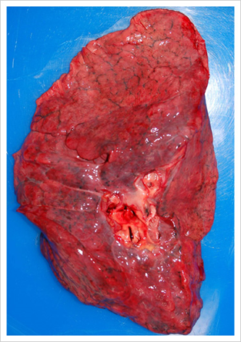
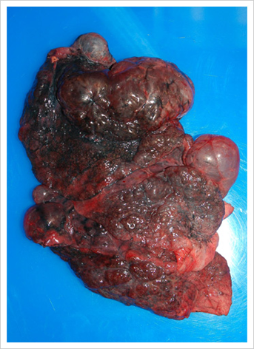
Smoking and Your Lungs
Healthy lung
Smoke-damaged lung

Slide 27
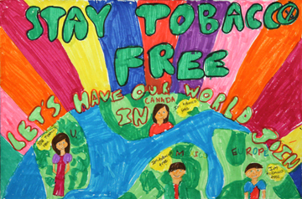
Did you know?
Tobacco use kills 480,000 people in the United States each year and nearly
6 million people
worldwide.
Many of these people started smoking as children.
Madelyn—Nevada
2011 Poster

Slide 28
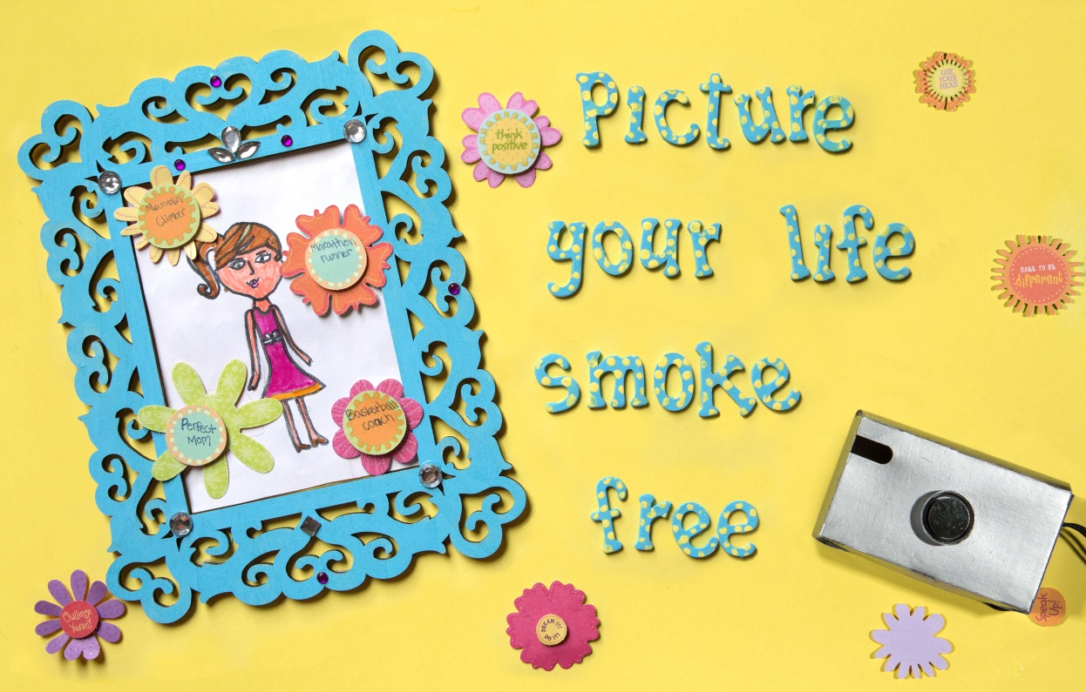
Remember…
Any type of tobacco or nicotine product
harms you and those you care about.
Zoe—Mississippi
2014 Poster

Slide 29

Thank you for participating in Tar Wars!
Tar Wars is supported in part by the
American Academy of Family Physicians Foundation

Slide 30



Questions?
www.tarwars.org
www.facebook.com/TarWars
www.youtube.com/AAFPTarWars

